Slide 1
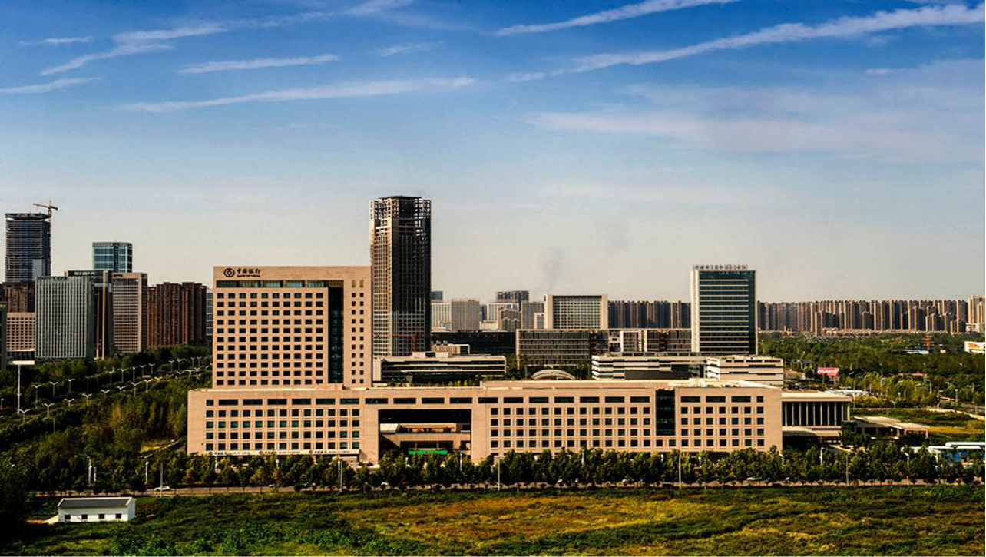
2021 Call for code
Poverty Conqueror

Slide 2
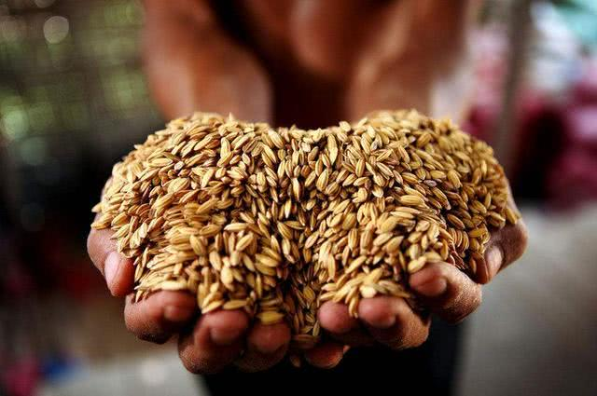
1. Creative background
2. Initial work
3. Creative introduction
4. Team Member

Slide 3
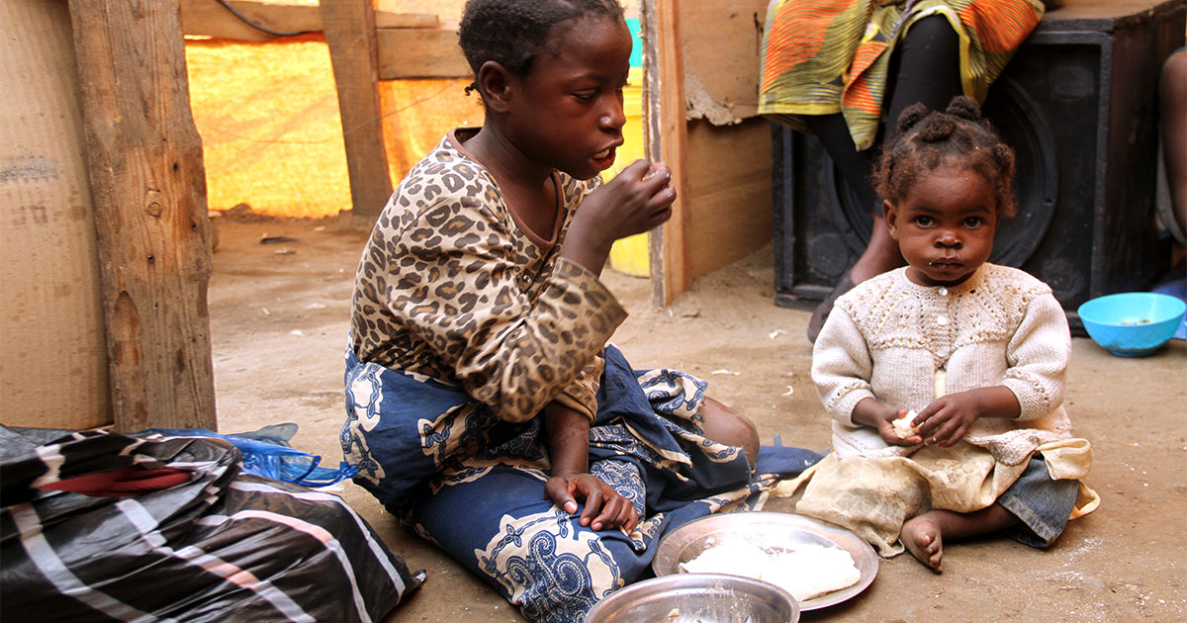
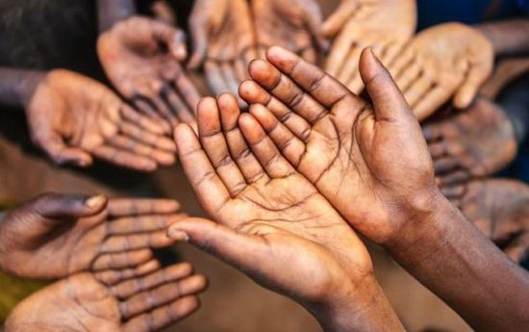
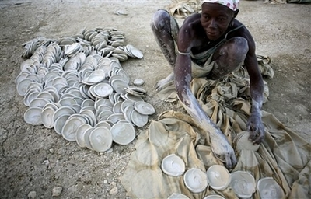
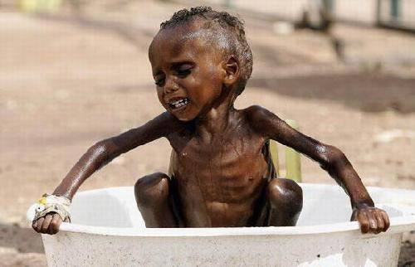
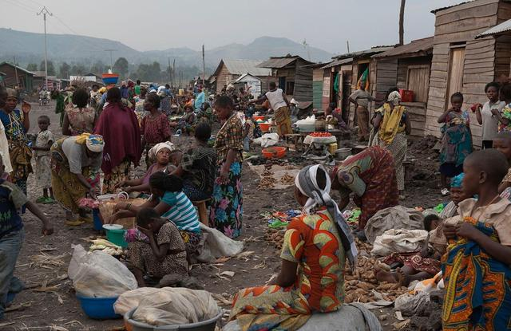
Poverty in the world

Slide 4
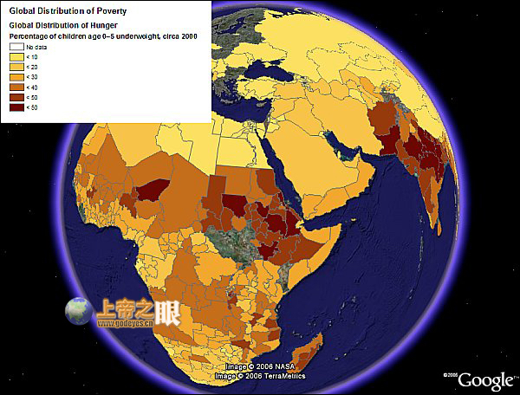
Poverty in the world
According to the 2020 Global Multidimensional Poverty Index (MPI), 1.3 billion people (22%) of 107 developing countries live in multidimensional poverty, mainly in Asia, Africa and Latin America.

Slide 5
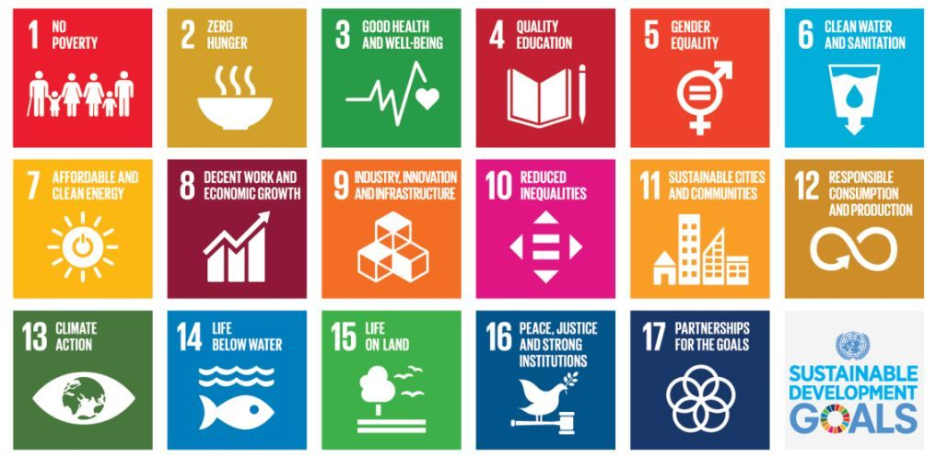
Sustainable Development Goals

Slide 6
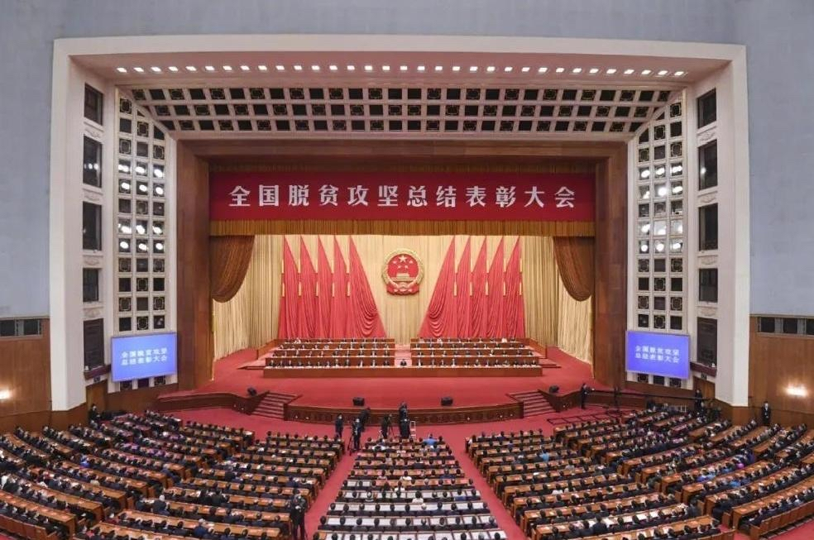
China's poverty alleviation achievements
As of November 2020, China's 832 national-level poverty-stricken counties have all been lifted out of poverty, and 55.75 million rural poor people have been lifted out of poverty, and the United Nations poverty reduction goal has been achieved 10 years ahead of schedule.

Slide 7
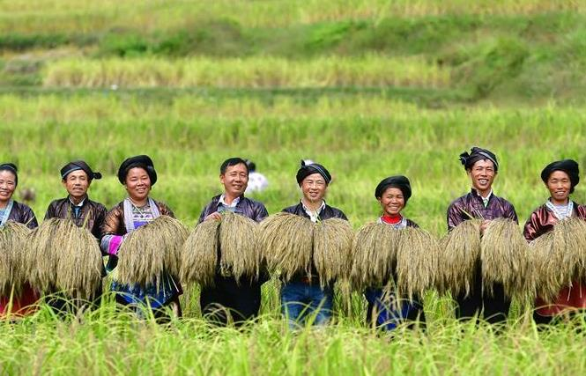
Thinking
As a pioneer of successful poverty alleviation,
How can China's experience be used for other poor areas to learn from?
As a technician,
How can I use my expertise to solve the problem of global poverty alleviation?

Slide 8
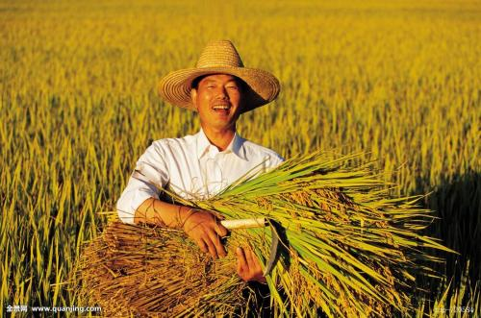
Initial work
1. Analysis of poverty alleviation experience
Collect the cases of hat removal in poor counties in China, analyze the factors causing poverty and the key to poverty alleviation, and establish a reference case database.

Slide 9
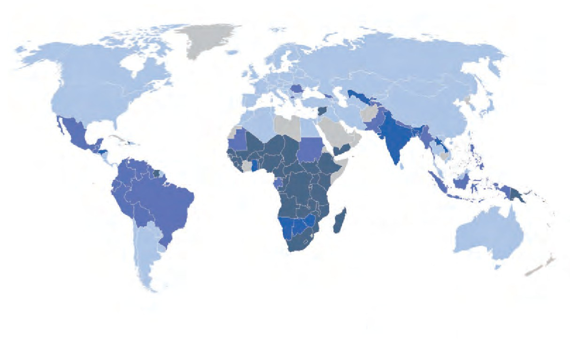
Initial work
2. Information on poverty-stricken areas
Collect information on poverty-stricken areas around the world and analyze it from the dimensions of climate, topography, altitude, air humidity, region, soil quality, light, and economy.

Slide 10
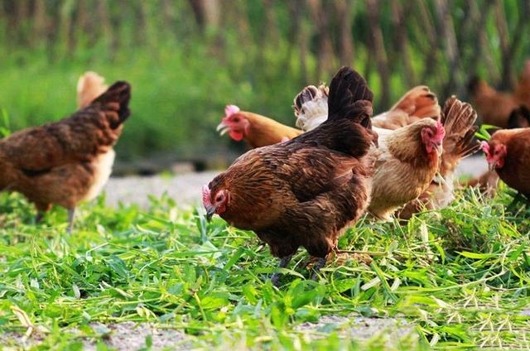
Initial work
2. Industry Database
Collect information on characteristic industries such as crops, aquaculture, labor-intensive industries, or tourism that are in good conditions in the global market, and establish an industry database.

Slide 11

Initial work
2. Difficulties Analyze
Analyze the sources of funds and the ways to overcome difficulties in the process of poverty reduction.

Slide 12
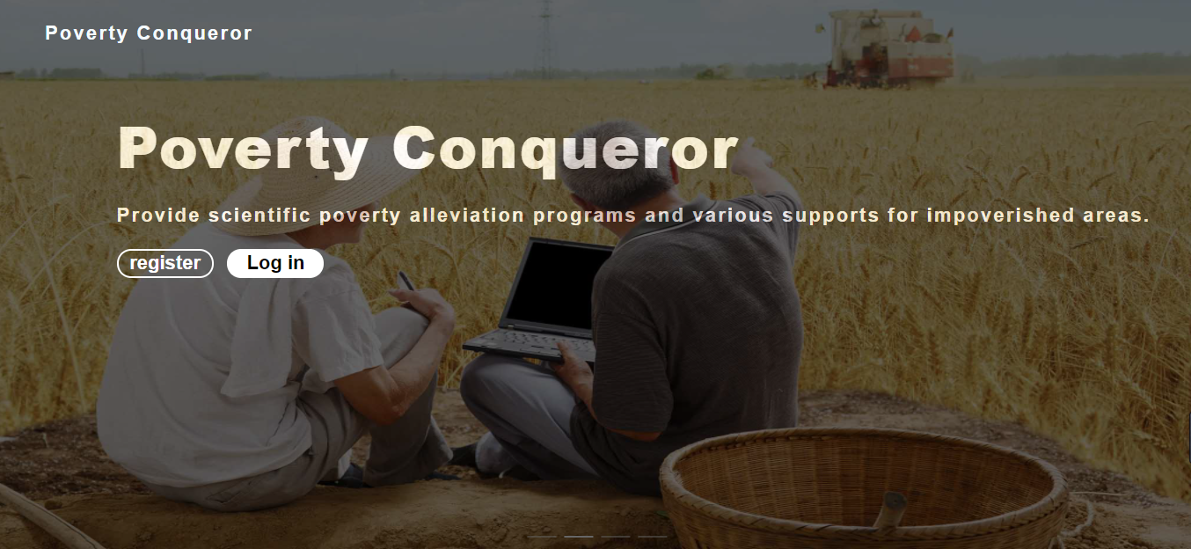
Creative introduction

Slide 13

Creative introduction
Our creative Poverty Conqueror aims to start from China’s poverty alleviation experience and provide characteristic poverty alleviation solutions for poverty-stricken areas around the world through data analysis, machine learning, data cloud and other technical means, to solve poverty problems and achieve sustainable development.

Slide 14
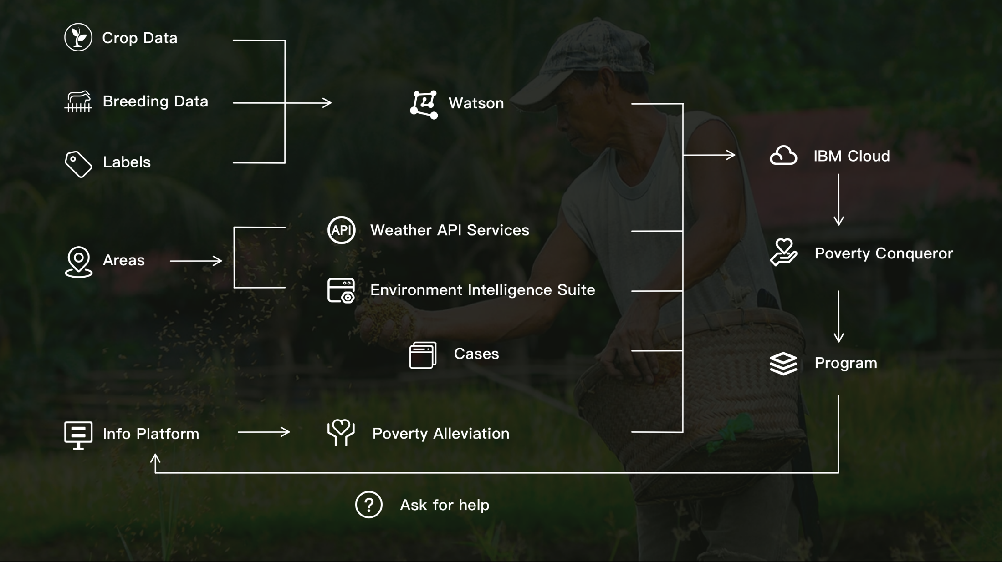
Architecture design

Slide 15
Architecture design
We use IBM cloud pak for data to process data of 8 latitudes of crop, breeding, and characteristic industries, and use IBM Watson studio for machine training to generate industry recommendation models.

Slide 16
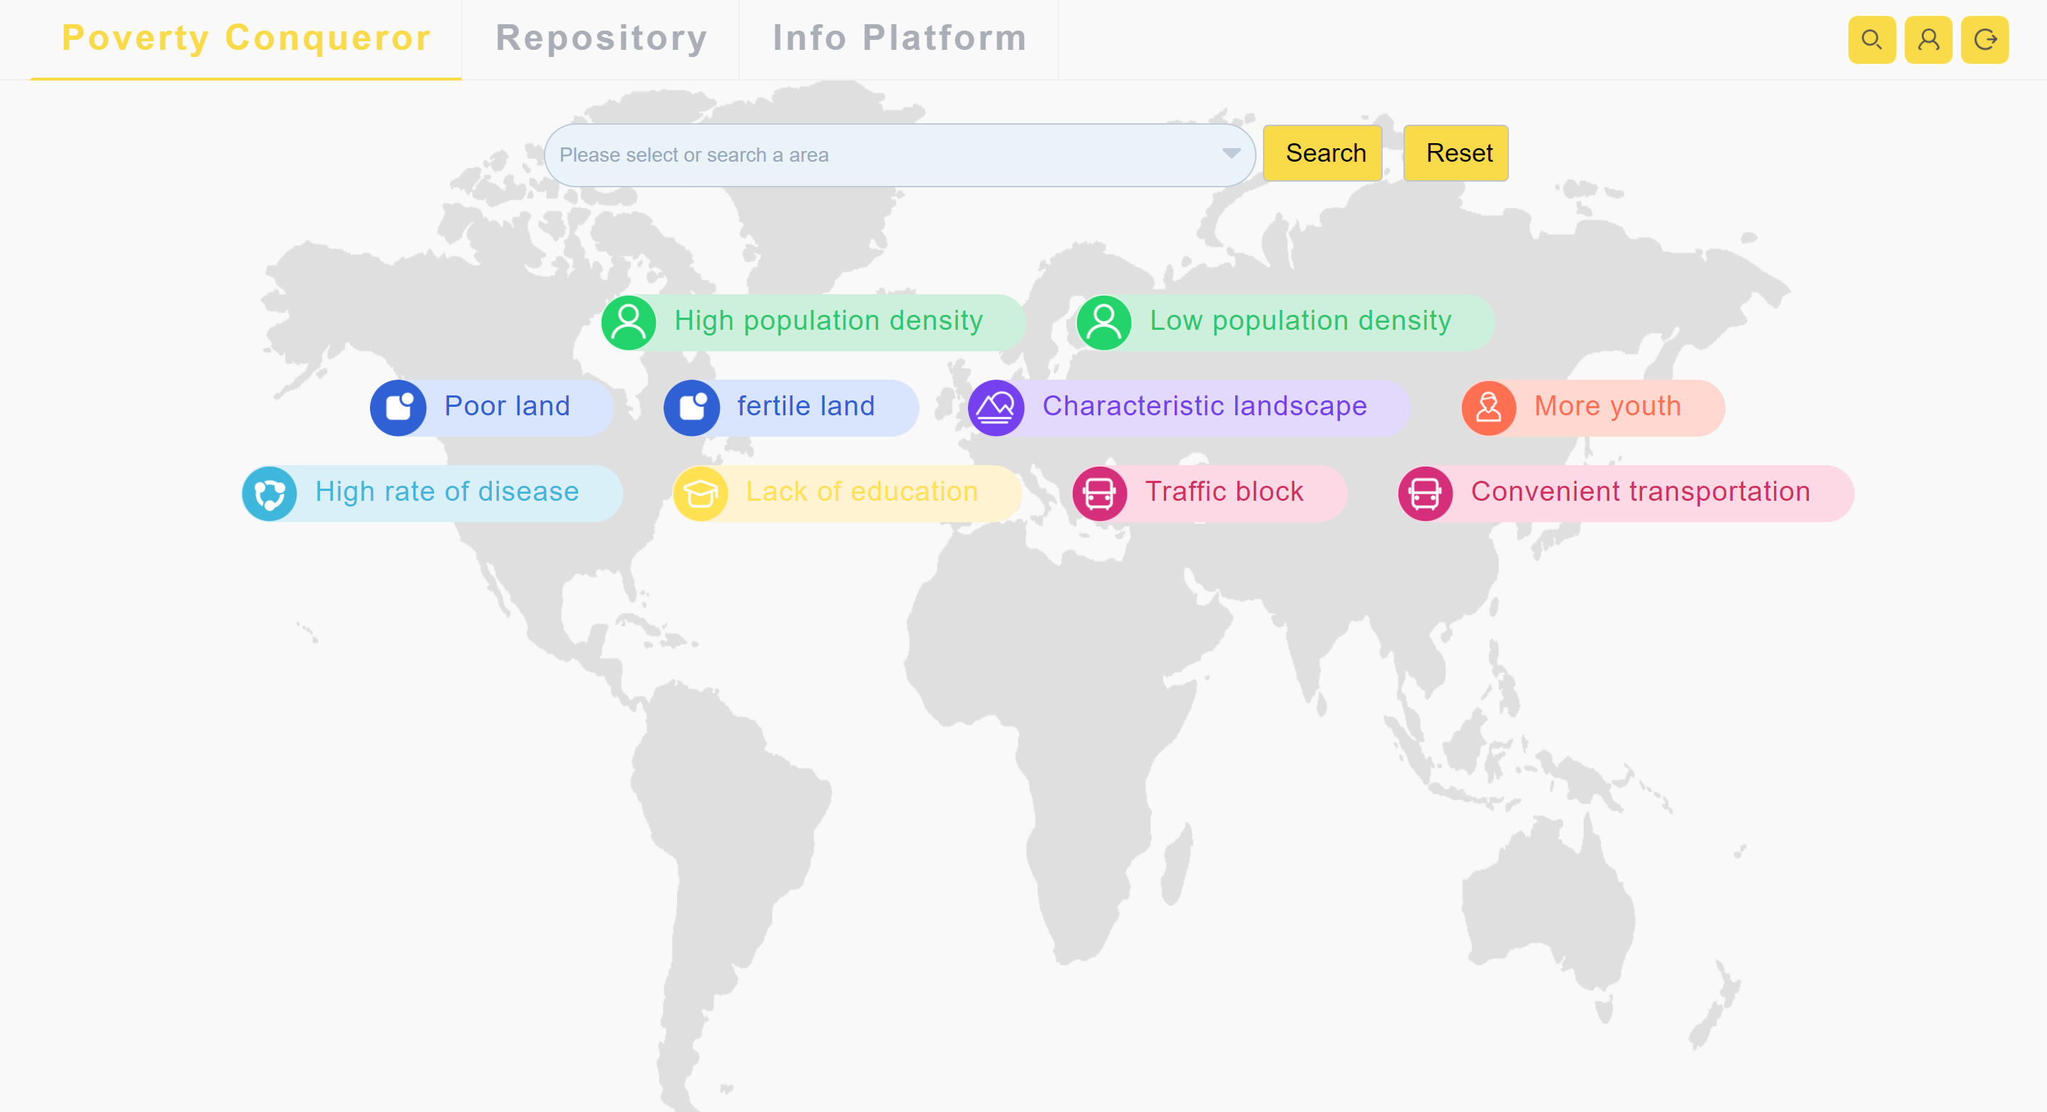
Function Design

Slide 17
Function Design
After logging in to the website, the user selects the region in the drop-down box, or selects the characteristic label according to the local situation. The backend searches the database for basic information of the region, and calls weather company data packages and environmental intelligence suite at the same time to generate 8 dimensions of basic information and return it to Users, including climate, terrain, altitude, air humidity, region, soil quality, light, and economy.

Slide 18
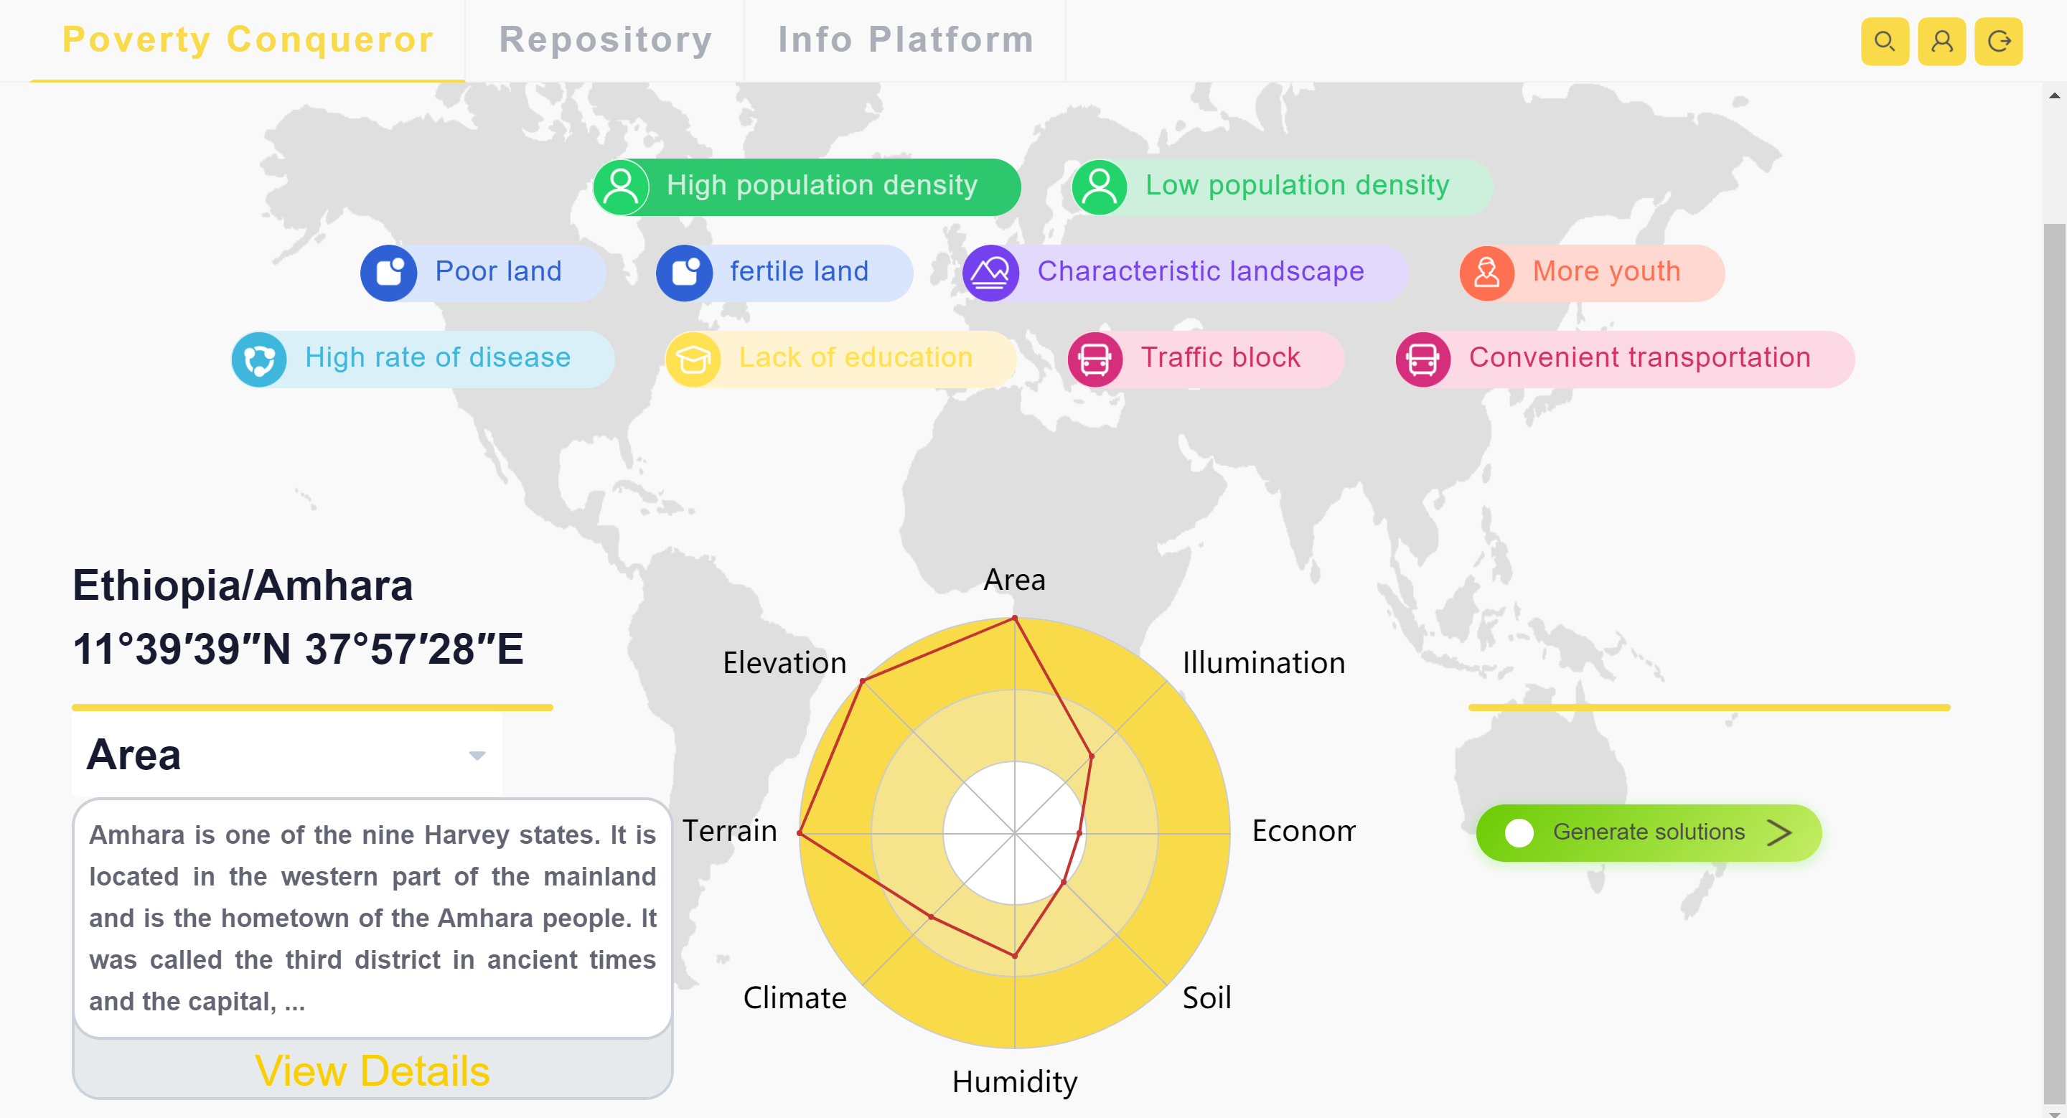
Function Design

Slide 19
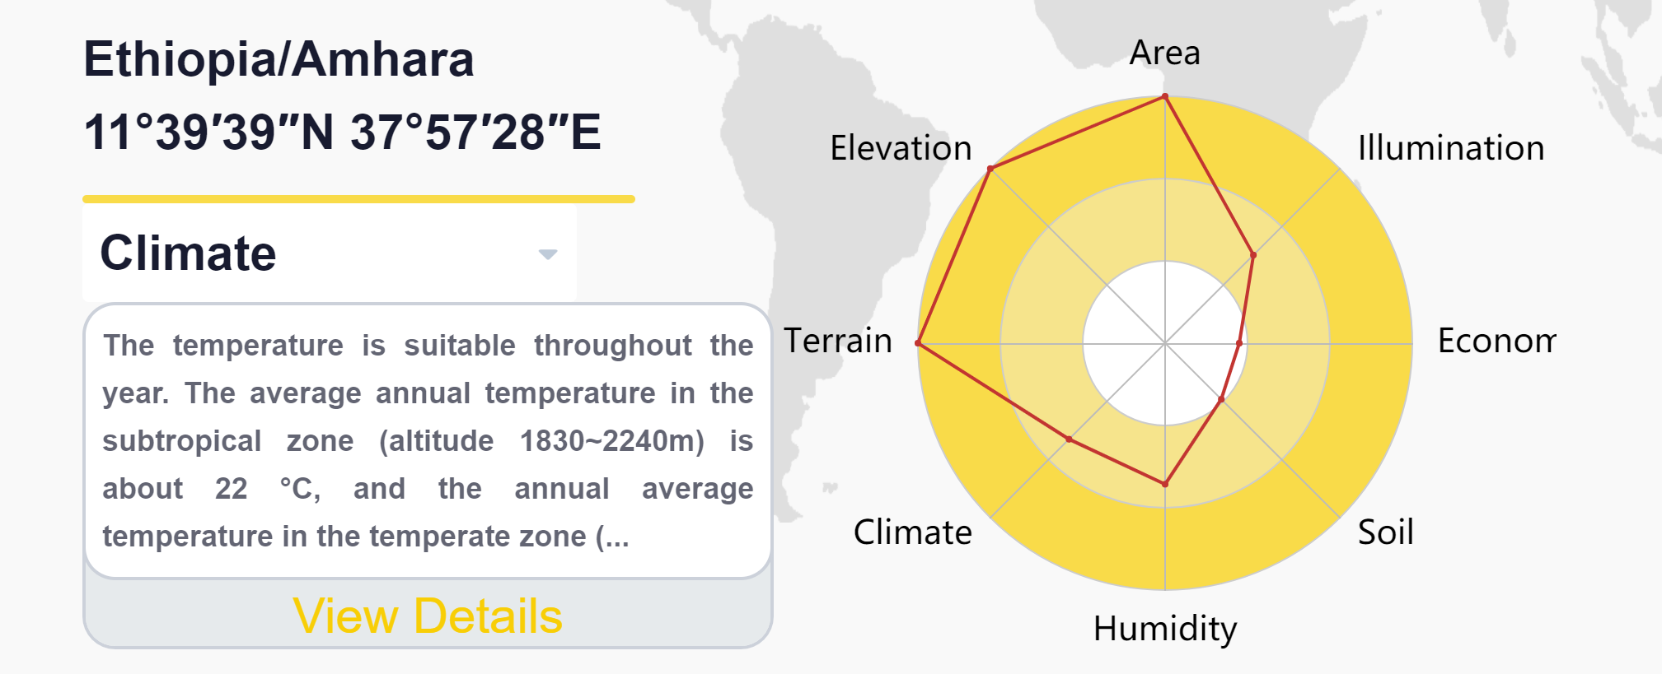
Function Design
Click on a different point on the dimensional map to display detailed information about that latitude

Slide 20
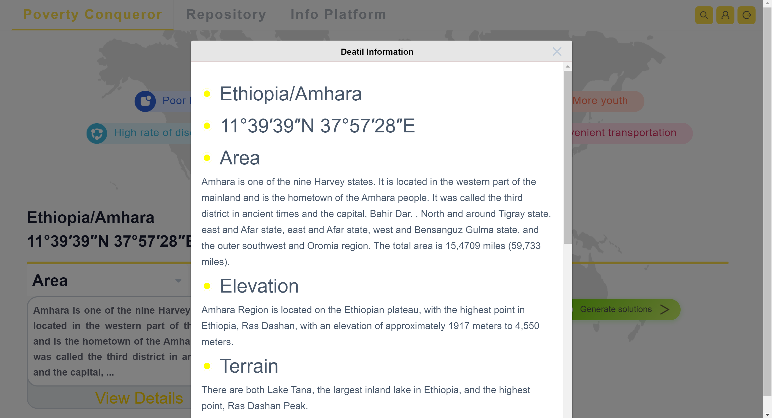
Function Design

Slide 21
Function Design
Click "Generate Plan", the back-end calls the trained AI model through API service, enters 8 dimensions of information, and generates a set of poverty alleviation plans, including three modules: industry recommendation, case recommendation, and support agency recommendation.

Slide 22
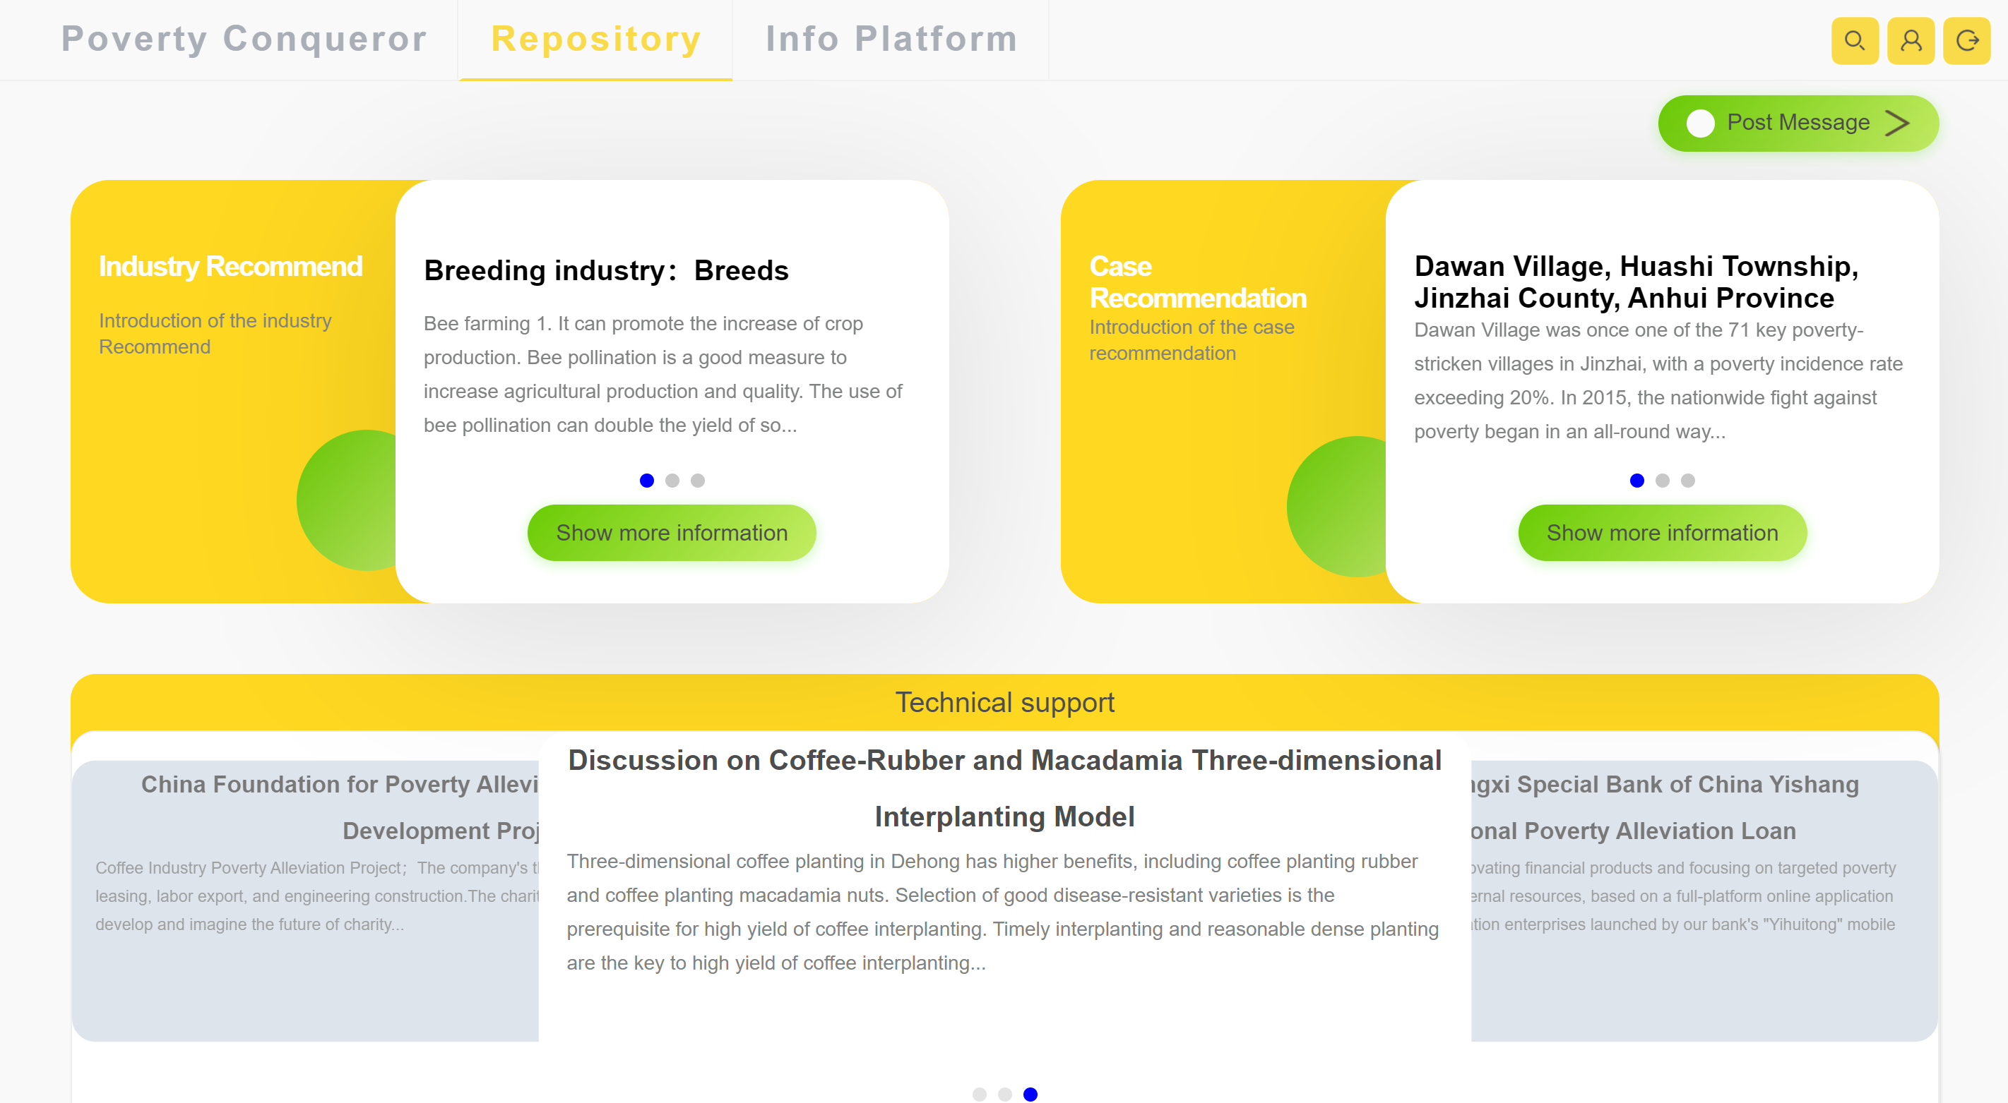
Function Design

Slide 23
Function Design
Recommend the development of industries, including crop planting, animal breeding, or handicraft industry, tourism and other characteristic industries. They can be developed individually or in combination.

Slide 24
Function Design
According to different recommended industries, enter keywords into the China poverty alleviation case database to search, and match the closest 2-3 successful cases for reference

Slide 25
Function Design
At the same time, search for suitable financial services (project loan services), charity organizations (project charity support) and technical institution information (industrial technology teaching) in the information platform for the development industry and recommend them to customers

Slide 26
Function Design
The website supports the function of an information platform. Users can post help posts according to the poverty alleviation plan obtained. Banks, charitable organizations and technology companies can also post help posts to establish contact channels for help seekers and donors in poverty alleviation development.

Slide 27
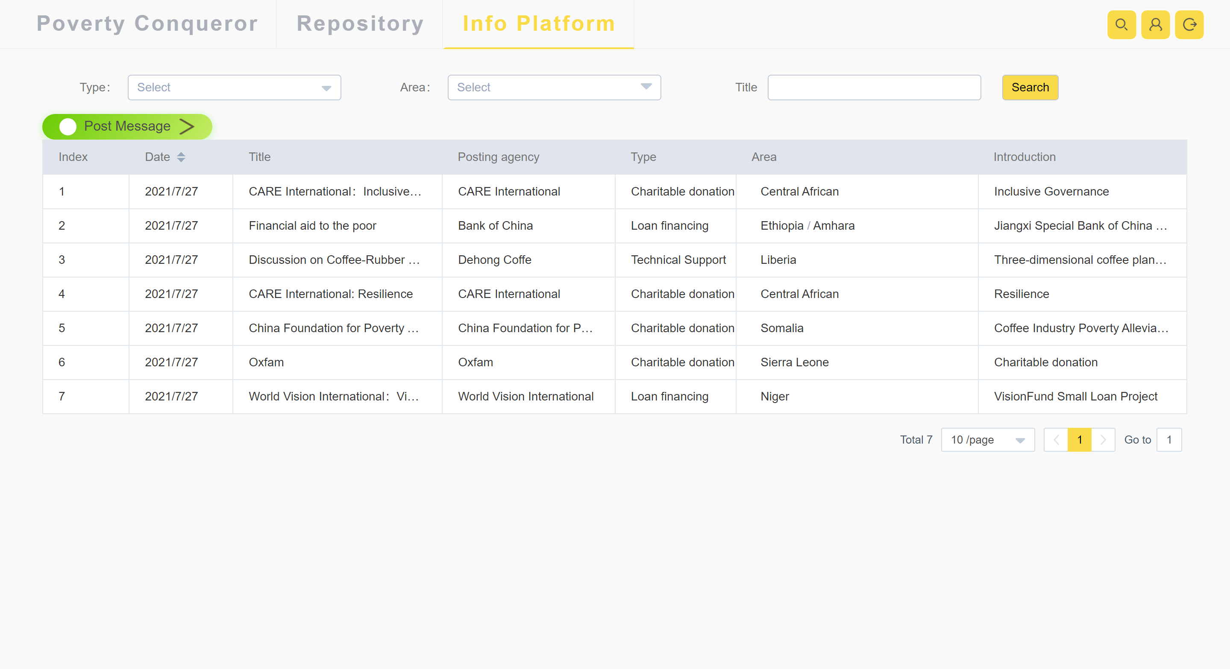
Function Design

Slide 28

Social value
Integrate local soil quality and climate information, quickly match the industries that are most suitable for poverty alleviation, and recommend development directions for poverty-stricken areas in the world;
Integrate business information, recommend corresponding financing channels, establish connections between industries, banks and charitable organizations, and provide development paths for poverty-stricken areas, while also broadening investment channels for banks and other financial institutions.

Slide 29
Social value
Integrate technical resources, recommend technical support institutions, provide technical guidance and support for the development of industries in poor areas, and provide channels for secondary development of related industries.
Integrate risk information, provide financial hedging plans, and bring insurance and futures institutions into poverty alleviation plans, which can not only solve the development failures and difficulties of poor areas, but also reduce investment risks for financial institutions that provide financial support. Expand insurance and futures business.

Slide 30
Follow-up Work
In the follow-up, the industry development tracking function will be further expanded, through the IBM lot module and image recognition technology to obtain plant and animal growth status and real-time weather, air humidity, soil humidity and other information, predict the growth trend, and help users to monitor in real time.

Slide 31

Future expectations
Poverty Conqueror can provide practical development plans, China’s development path and achievements, and follow-up service support for poverty-stricken areas. We sincerely hope that it can help poor areas around the world, so that everyone has food, clothing, school, medical treatment, and dreams.

Slide 32
Team Member
Mingwei Zhang：Creative Analyst, System Designer
Mengqi Cai：Product and software developers
Yaoyang Liu：Product and software developers
Xiaoming Yang：Artificial intelligence engineer
Tianhao Wang：Web developer，UI designer

Slide 33
Seeking attention !

